Slide 1
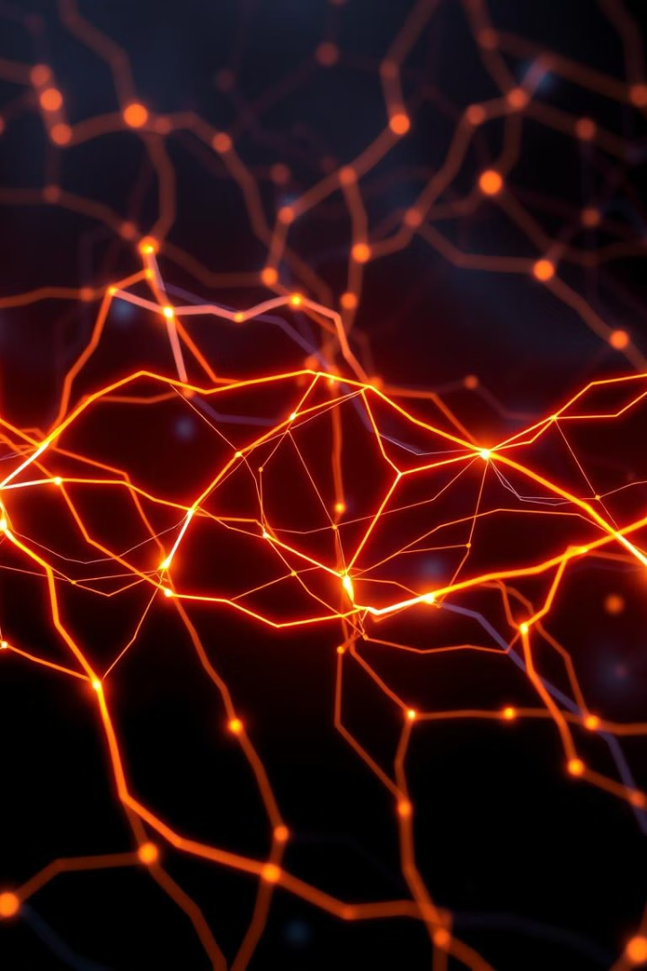


Keras: The User-Friendly Neural Network Library
2 Contributors

Slide 2
Objective: Simplicity and Accessibility in Deep Learning
Democratizing Deep Learning
High-Level API
Keras makes deep learning accessible by prioritizing ease of use and rapid prototyping.
It abstracts away complex backend operations, making deep learning simpler for users.

Slide 3
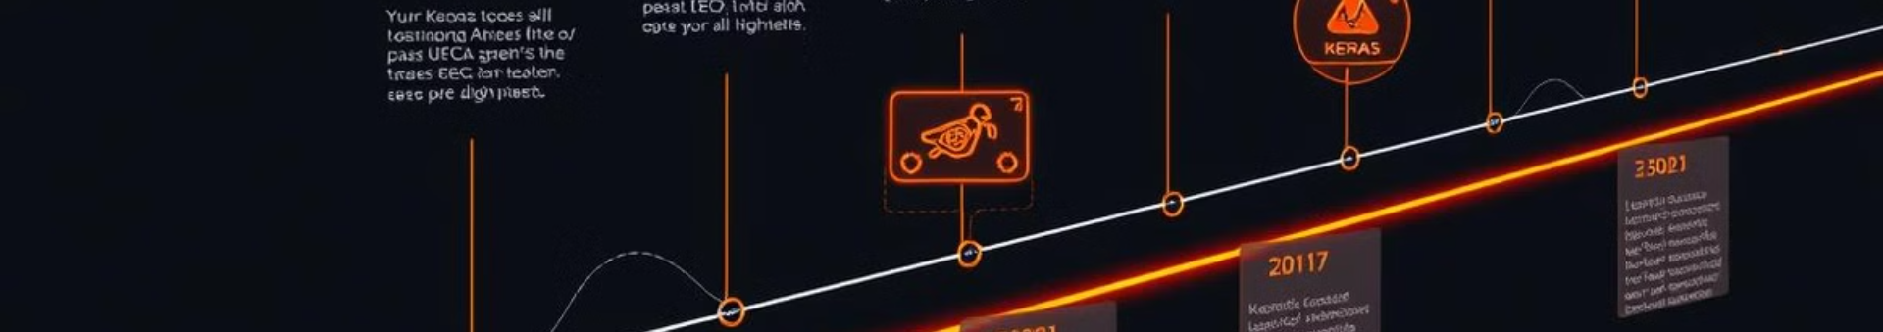
A Brief History of Keras
2015
1
Keras was first released by François Chollet, a Google engineer.
2
2017
Keras was integrated with TensorFlow as tf.keras, solidifying its role as the standard high-level API.
2023
3
Keras 3.0 was released with multi-framework backend support.

Slide 4

Keras's Impact on the Current Tech Landscape
1
Accelerated Adoption
Keras has lowered the barrier to entry for deep learning.
2
Proliferation of Applications
Keras has enabled faster development cycles in domains like image recognition and NLP.

Slide 5

Keras: Empowering Researchers and Developers
Rapid Experimentation
Keras enables building and testing models quickly, facilitating iteration.
Clear Code
Keras code is highly readable and maintainable, leading to better collaboration.

Slide 6
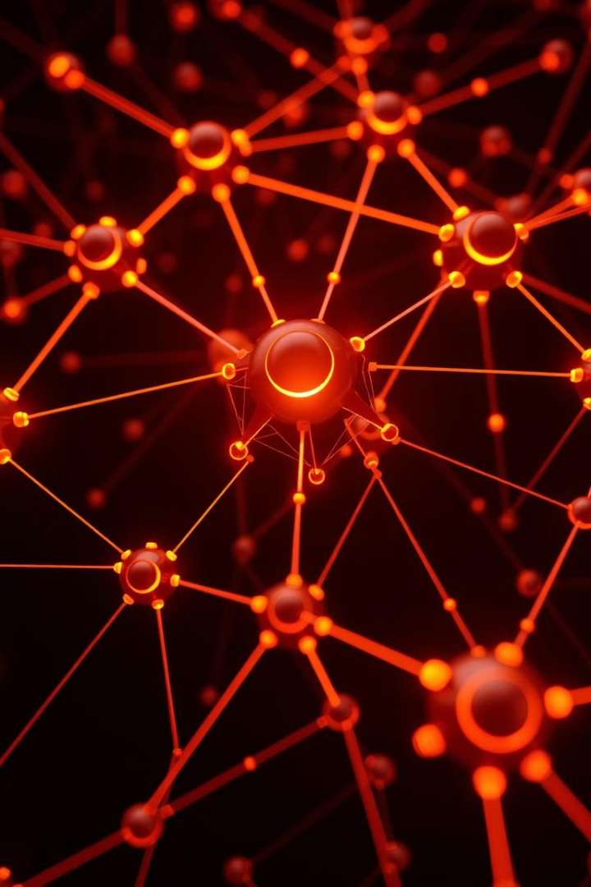


Future Impact: Keras as a Unifying Force
Multi-Framework Support
Keras 3.0 allows running models on different backends, like TensorFlow, JAX, and PyTorch.
WebAssembly and Mobile Deployment
Keras models can be deployed on edge devices and in web browsers with ease.

Slide 7
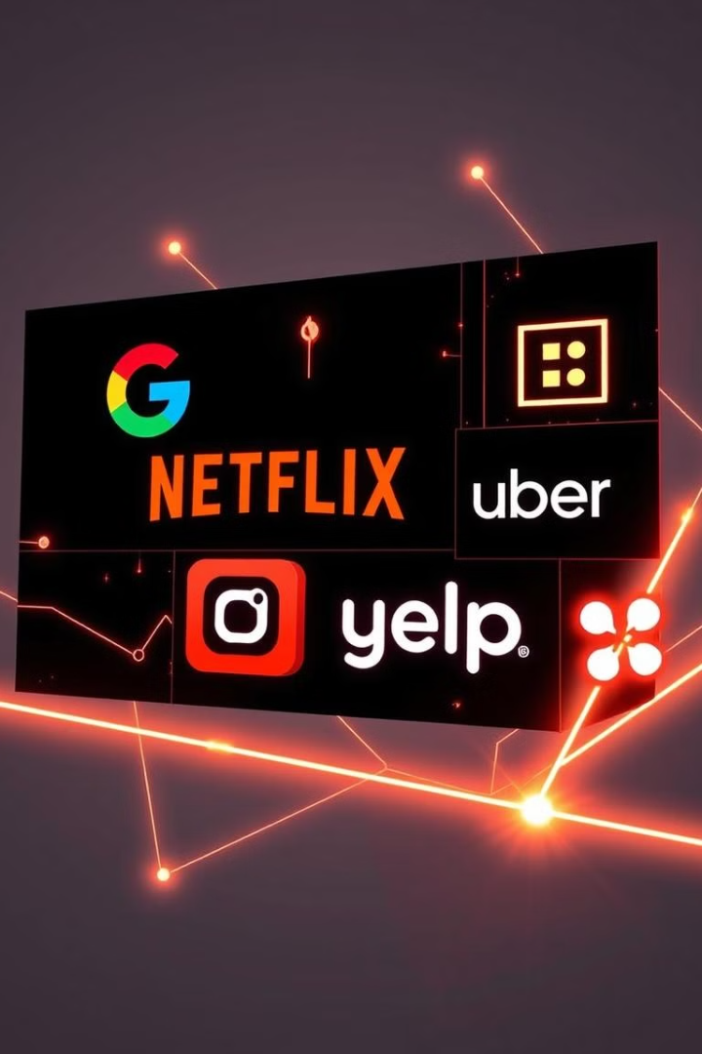



Companies Using Keras: Driving Innovation Across Industries
Internal research and product development, including TensorFlow integration.
Recommendation systems and content understanding.
Fraud detection and ETA predictions.

Slide 8



Case Study: Netflix's Recommendation Engine
Challenge
1
Personalize content recommendations for millions of users.
Solution
2
Keras-based deep learning models for collaborative and content-based filtering.
Impact
3
Improved user engagement, reduced churn, and increased subscription revenue.

Slide 9
The Future is Bright: Keras and the Next Generation of AI
Accessibility
1
Increased accessibility for non-experts.
Hardware Integration
2
Seamless integration with emerging hardware platforms.
Ethical AI
3
Emphasis on ethical AI and responsible development.

Slide 10
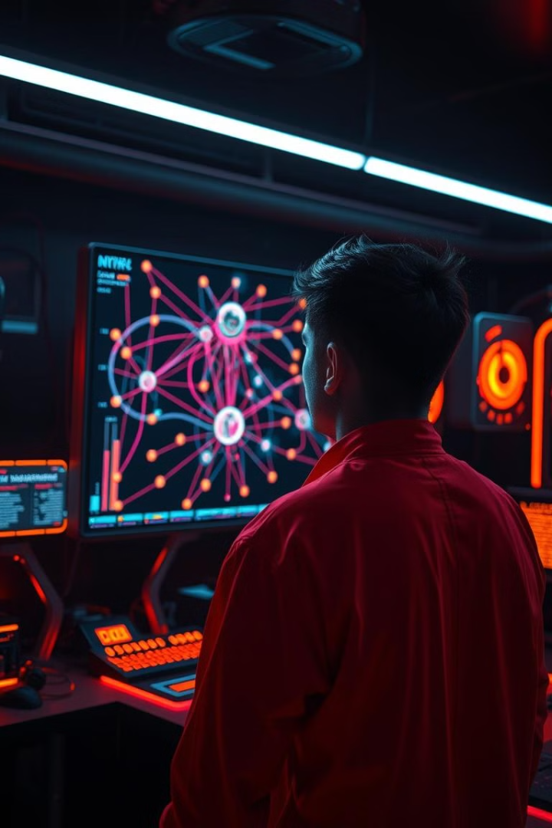
Conclusion: Keras - Powering the Future of Deep Learning
Keras has democratized deep learning, making it accessible to a wider audience. Its ease of use, flexibility, and multi-framework support position it as a key player in the future of AI. Companies across industries are leveraging Keras to drive innovation and solve complex problems.

Slide 11

Flowchart for the code

Slide 12

Code

